Slide 1

Final year Major Project presentation
Welcome to
Health-Care-Hub
Second Phase

Slide 2




Project Team Members
Masscelius L.Jimmy
William Kuach
Emmanuel Charles
Emmanuel Khamis

Slide 3
What is Health-Care-Hub?
Health-Care-Hub is a blockchain-Based medical record management system that de-centralizes the access control of patients record from one individual medical center to the patient himself/herself
Problem Statement
Current healthcare systems face several issues:
Patient records are locked within individual hospitals
No unified medical history across hospitals
Patients have little or no control over data access
Data duplication, delays, and privacy risks
Centralized databases are vulnerable to breaches
Proposed Solution
Health-Care-Hub is a blockchain-based web application that:
Stores patient medical records independent of hospitals
Gives full control to patients over their data
Allows hospitals to access records only with patient permission
Ensures security, transparency, and immutability

Slide 4
System Overview
The system consists of:
Patients (Users)
Hospitals / Clinics
Blockchain Network
Web Application Interface
Smart Contracts
Records are stored securely and referenced via blockchain hashes.

Slide 5
Key Features
Hospital Module
Hospitals can:
Register and verify identity
Request access to patient records
View records only after patient approval
Upload treatment updates (with consent)
Subscribe for institutional access
Patient Module
Patients can:
Register and create a secure digital health identity
Upload and manage medical records
Grant or revoke access to specific hospitals
View access history of their data
Subscribe to the platform for advanced features

Slide 6
Methodology and Algorithm
Record Storage Methodology
Objective: Store medical records securely and independently of hospitals.
Process:
Medical records are encrypted on the client side
Encrypted files are stored in off-chain storage
A hash of the record is generated
Hash + metadata (patient ID, timestamp) are stored on blockchain
Record Storage Algorithm
Algorithm: Secure Record Storage
Patient uploads medical record
Encrypt record using patient’s private key
Store encrypted file in off-chain storage
Generate unique hash of stored file
Save hash and metadata on blockchain via smart contract
Confirm transaction and return record ID
Output: Immutable, verifiable medical record reference

Slide 7
Methodology and Algorithm
Record Management Methodology
Objective: Allow patients to manage and control their medical data.
Process:
Each record is linked to the patient’s blockchain address
Patients can:
View records
Update metadata
Delete off-chain data (hash remains immutable)
Record Management Algorithm
Algorithm: Record Management
Patient selects record from dashboard
System verifies patient identity
Fetch record metadata from blockchain
Perform requested action (view/update/delete reference)
Log action timestamp on blockchain
Update UI confirmation

Slide 8
Methodology and Algorithm
Record Access Control Methodology
Objective: Ensure hospitals access records only with patient consent.
Process:
Hospital requests access to patient record
Smart contract notifies patient
Patient approves / rejects / limits access
Access permissions stored on blockchain
Time-bound or record-specific access enforced
Record Access Control Algorithm
Algorithm: Access Permission Management
Hospital sends access request
Smart contract verifies hospital subscription
Notify patient dashboard
Patient grants or denies access
If approved:
Permission recorded on blockchain
Access token generated
Hospital retrieves encrypted record

Slide 9



Technologies Used
Frontend: HTML, CSS, JavaScript, React
Backend: Node.js / Django
Blockchain: Ethereum / Polygon
Database: IPFS / Cloud Storage

Slide 10

Patient-centric data ownership
Inter-hospital interoperability
Reduced paperwork and delays
High data integrity and trust
Scalable and future-ready system
Advantages
Of
Health-Care-Hub

Slide 11
Future Enhancements
AI-based health analytics
Integration with insurance providers
Mobile application
Government healthcare system integration

Slide 12
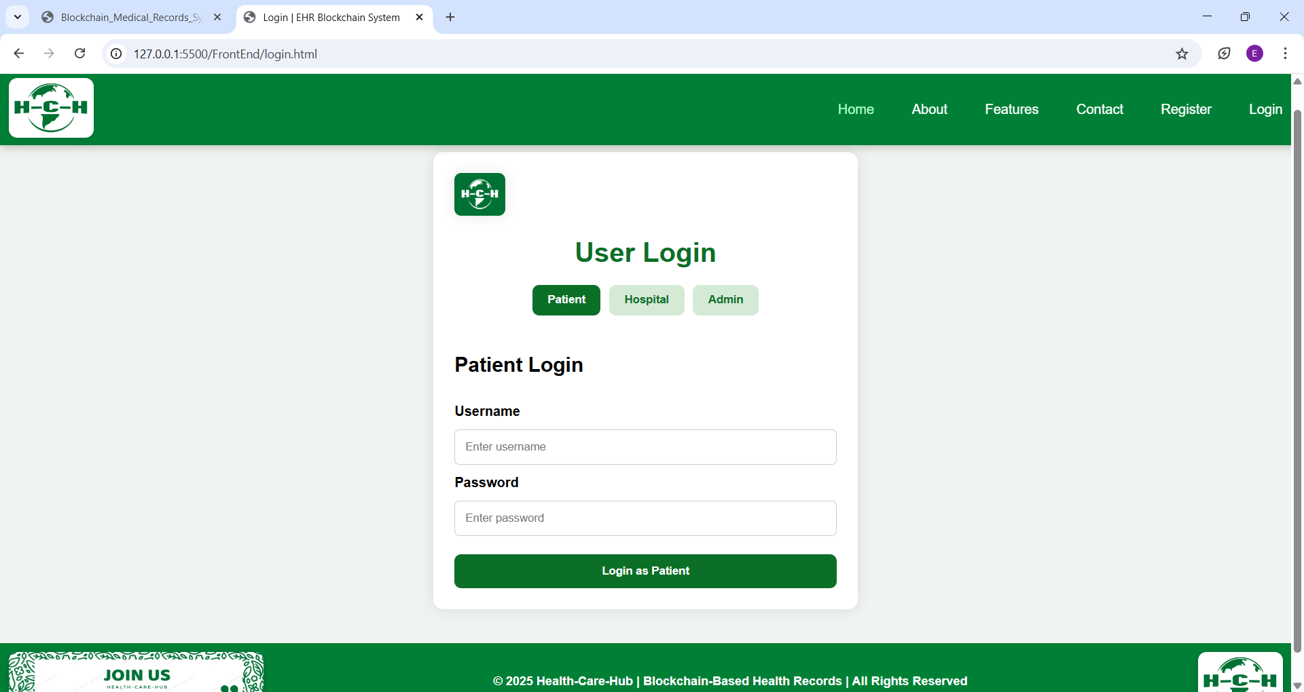
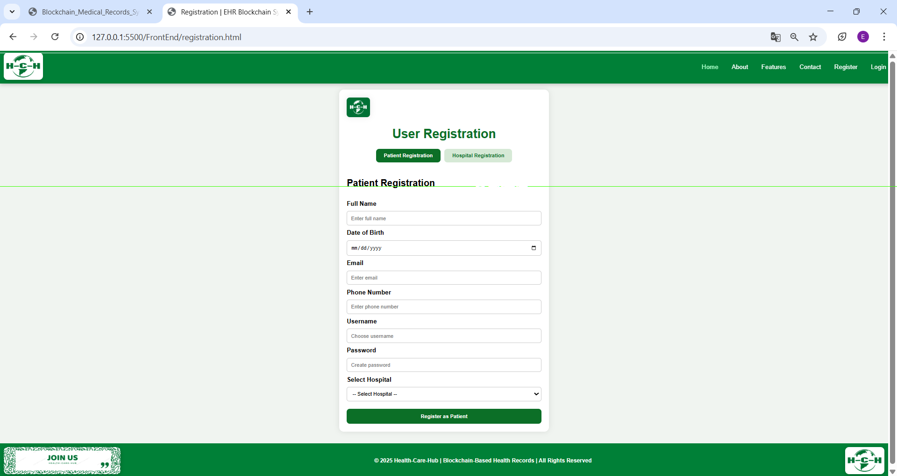
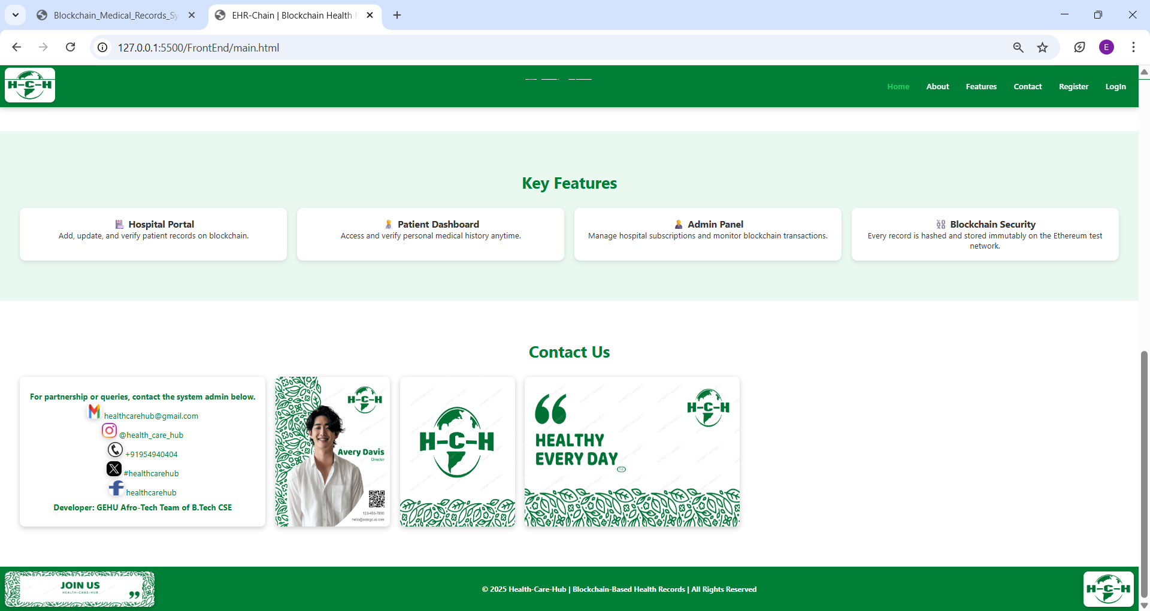
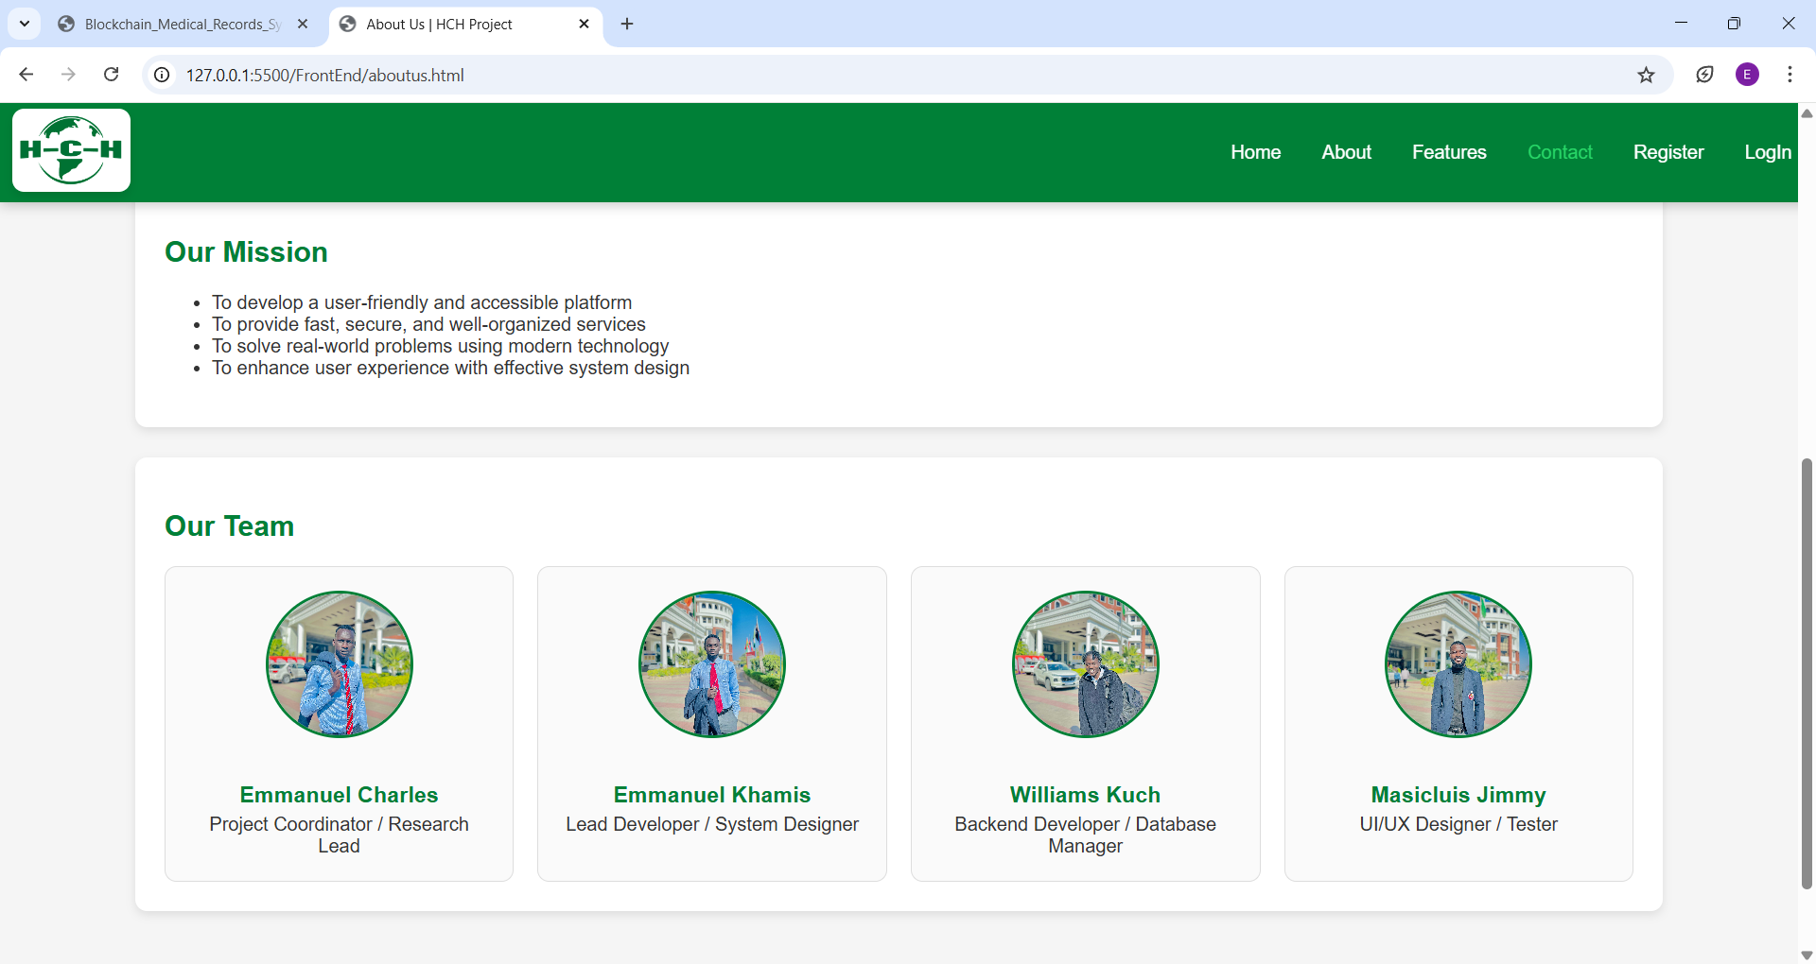

Slide 13
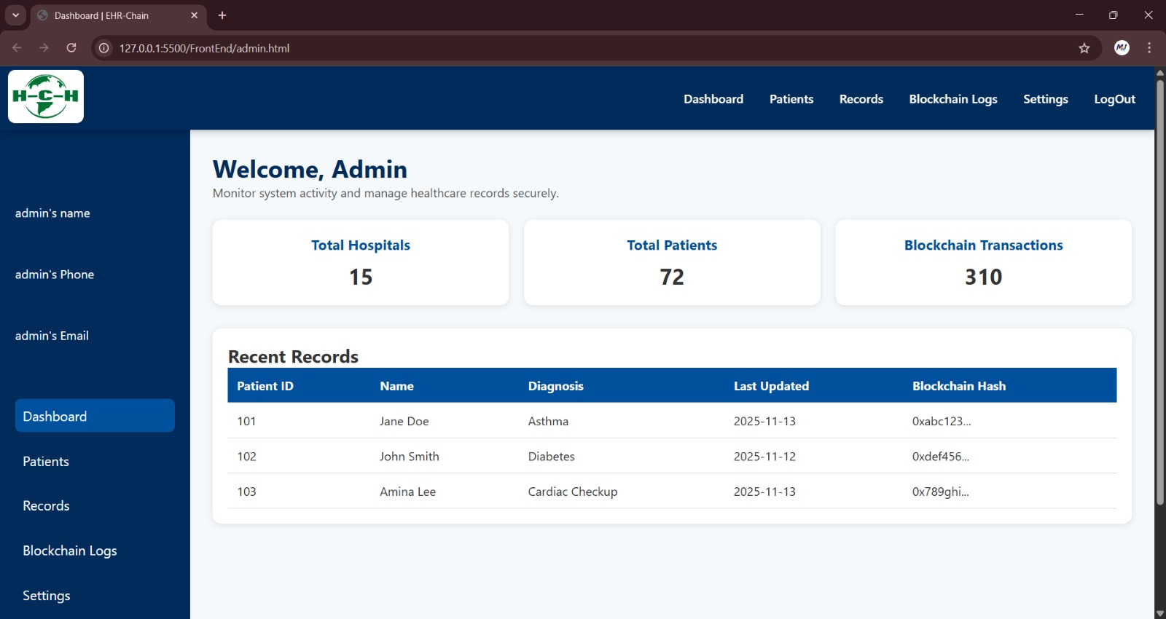
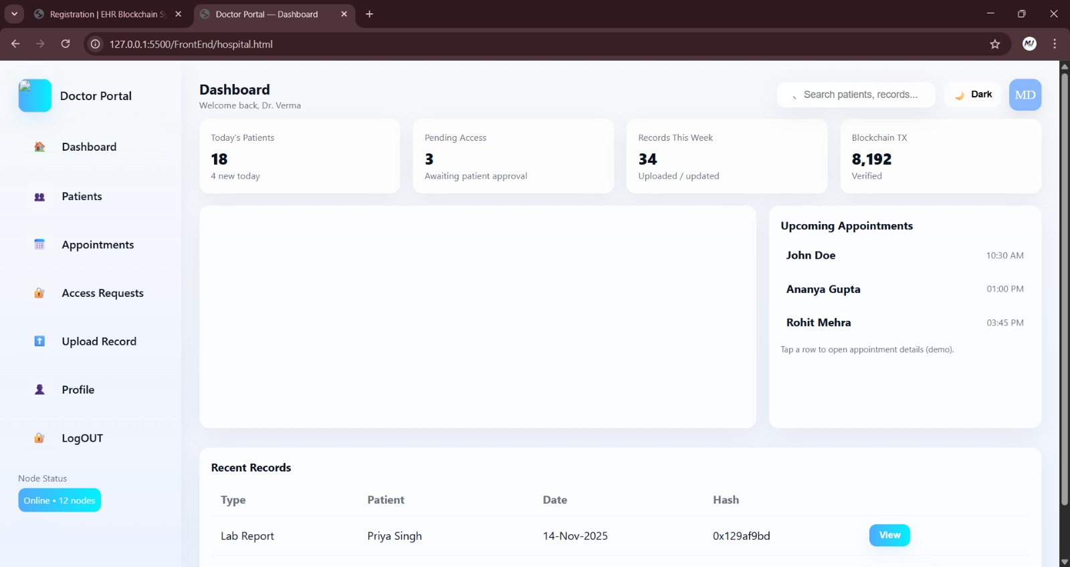
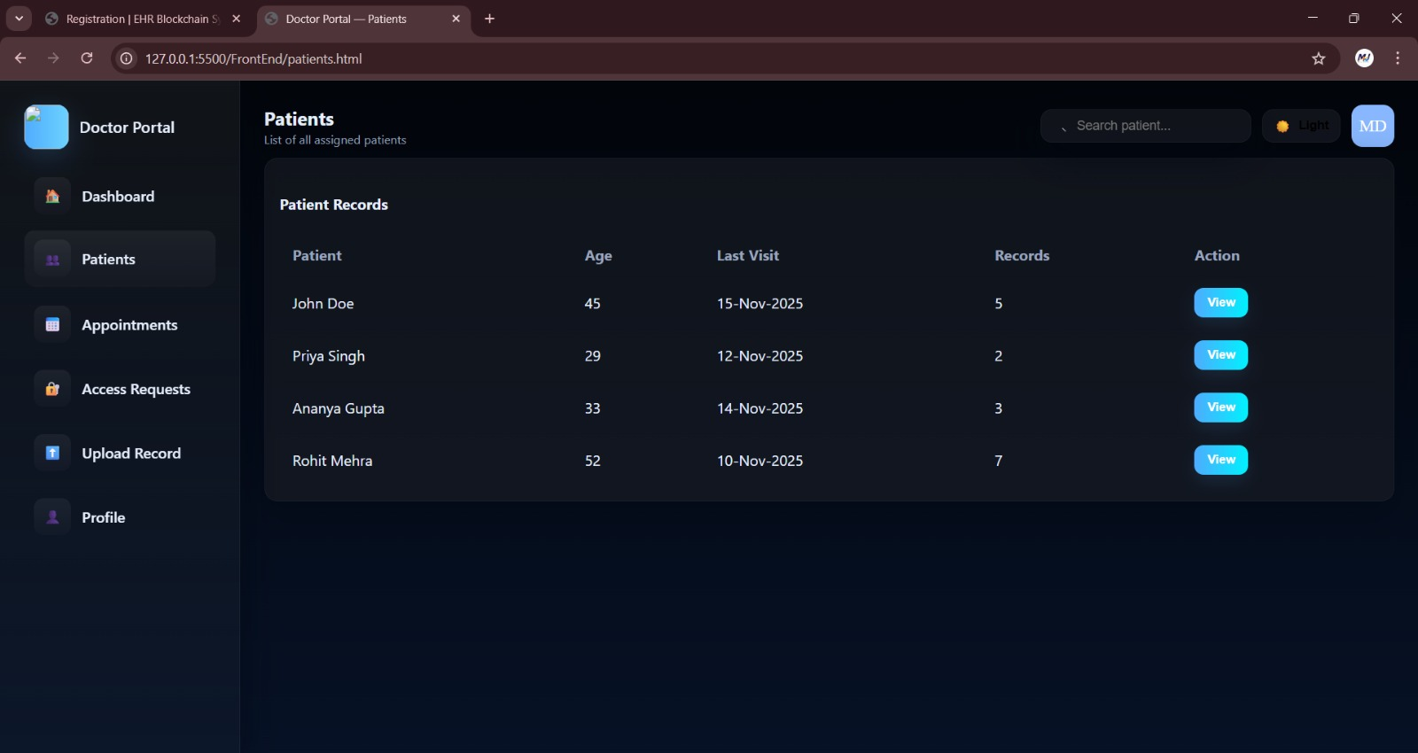
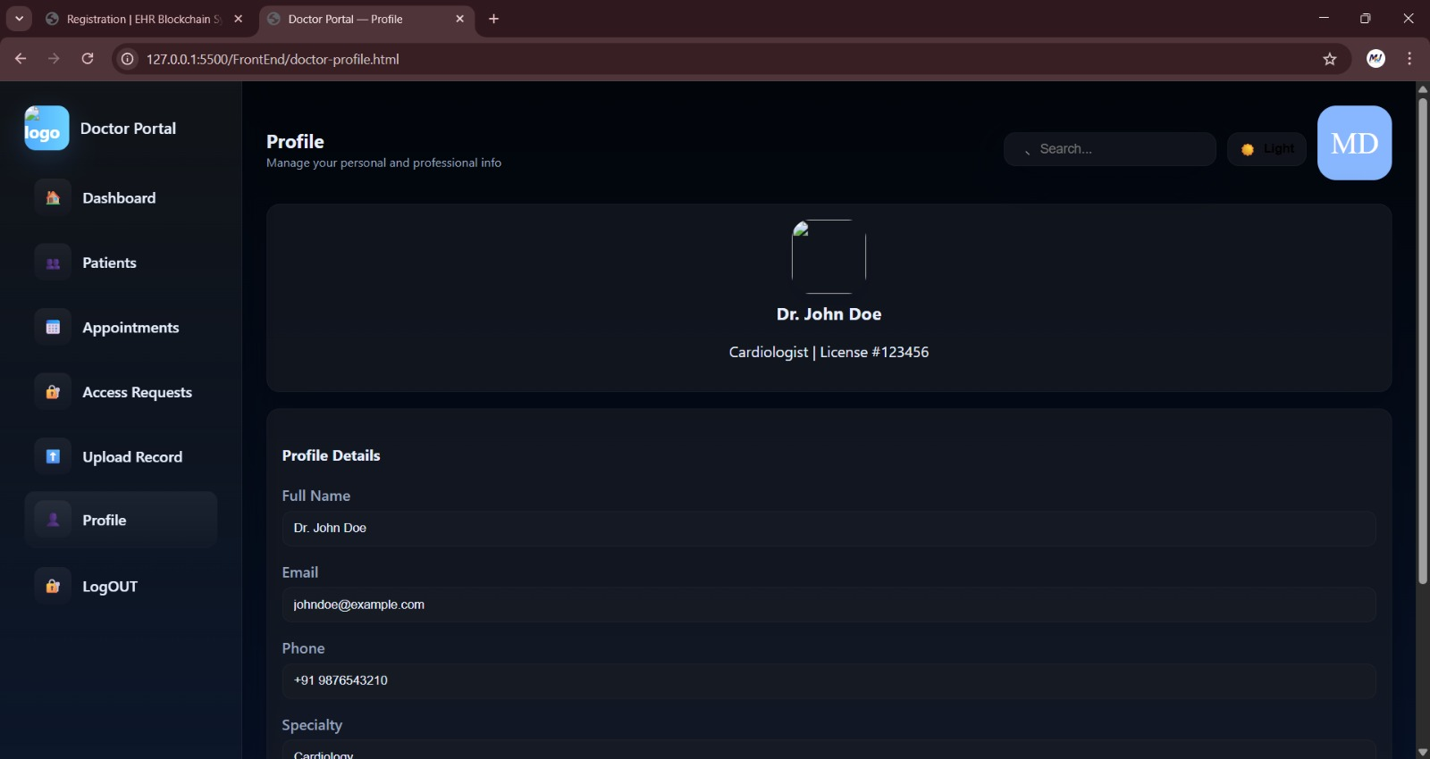

Slide 14
conclusion
The Health-Care Hub project presents a secure and patient-centric approach to managing medical records by leveraging blockchain technology. By decoupling health records from individual hospitals, the system ensures continuity of care and eliminates data silos that commonly exist in traditional healthcare infrastructures.
Through the use of smart contracts, the platform provides transparent, immutable, and controlled access to medical data. Patients remain the sole owners of their records and have full authority to grant, restrict, or revoke access to hospitals, thereby significantly improving privacy, trust, and data security.
Additionally, the subscription-based model makes the system scalable and sustainable for both patients and healthcare institutions. Overall, Health-Care Hub demonstrates how blockchain-based web applications can modernize healthcare data management, enhance interoperability, and empower patients with true ownership of their medical information

Slide 15
Thank You

